Slide 1

CLOTHES REVIEWS ANALYSIS WITH NLP
A Dissertation By
Yohan Hemal De Silva
DSA_0303
Instructed By
Dr. Sumudu Tennakoon
Machine Learning Foundation - Batch 03

Slide 2
INTRODUCTION
Natural Language Processing (NLP) is a field of Artificial Intelligence whose purpose is finding computational methods to interpret human language as it is spoken or written.
Why should we care? Well, because communication is important and NLP software can improve how businesses operate and, as a result, customer experiences.

Slide 3
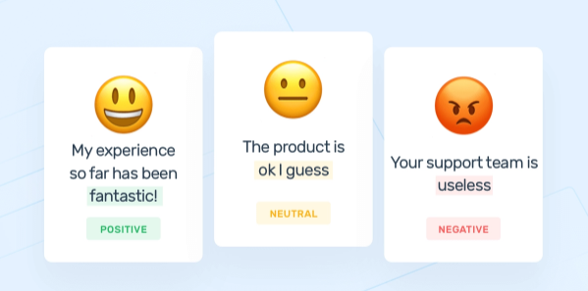
Sentiment Analysis (Opinion Mining)
Sentiment analysis, also referred to as opinion mining, is an approach to natural language processing (NLP) that identifies the emotional tone behind a body of text. This is a popular way for organizations to determine and categorize opinions about a product, service, or idea.
For this exercise, I’m also using Sentiment analysis techniques to predict sentiment of reviewed text.

Slide 4
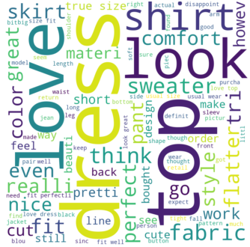

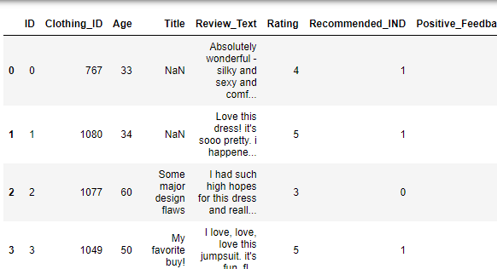
Problem Statement
In here I’m going to analyze the Women’s Clothing E-Commerce dataset which contains text reviews written by customers. The idea is predicting the sentiment of each review and see whether it is consistent with the reviewed text by the customer.

Slide 5
Data Set
This dataset includes 23486 rows and 10 feature variables. Each row corresponds to a customer review, and includes the variables:
Clothing ID: Integer Categorical variable that refers to the specific piece being reviewed.
Age: Positive Integer variable of the reviewers age.
Title: String variable for the title of the review.
Review Text: String variable for the review body.
Rating: Positive Ordinal Integer variable for the product score granted by the customer from 1 Worst, to 5 Best.
Recommended IND: Binary variable stating where the customer recommends the product where 1 is recommended, 0 is not recommended.
Positive Feedback Count: Positive Integer documenting the number of other customers who found this review positive.
Division Name: Categorical name of the product high level division.
Department Name: Categorical name of the product department name.
Class Name: Categorical name of the product class name.

Slide 6
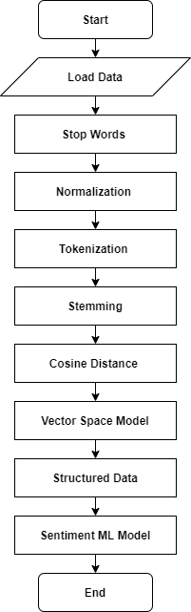
High – Level Process Flow
Some Key Functions
Stop Words
Lemmatization
Tokenization
Stemming

Slide 7
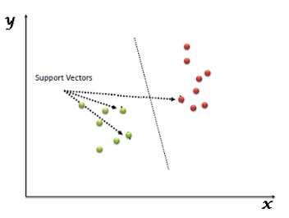
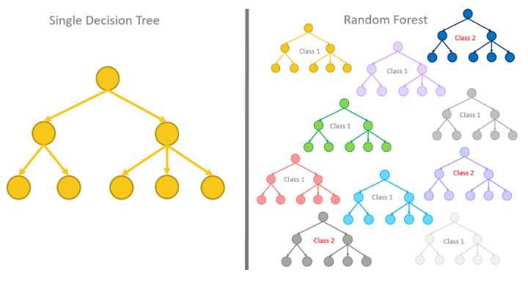
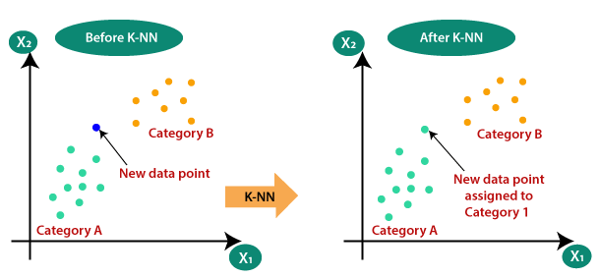
Machine learning approach
For the validate and verify the accuracy level, there are four machine learning models were deployed and tested for sentiment analysis with final data vocabulary.
Support vector machine
KNN Algorithm
Random Forest Algorithm
Multinomial Naive Bayes Algorithm

Slide 8
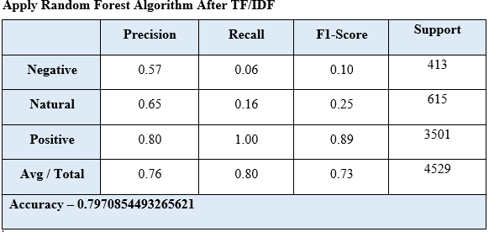
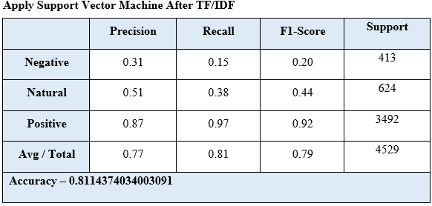
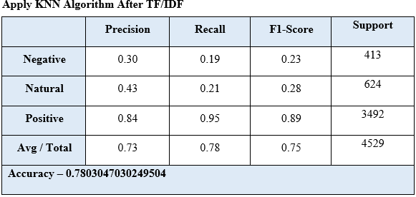
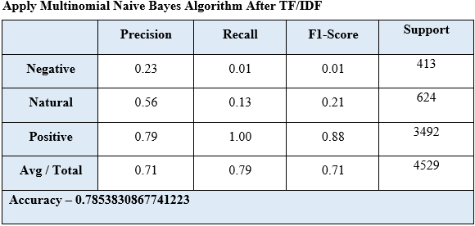

Accuracy

Slide 9
Conclusion
Since SVM (Support Vector Machine) has the highest accuracy level it is the best model for sentiment analysis among these deployed models. And also all of above models reach 0.78 of accuracy level with processed reviewed data set.
Sentiment analysis plays a pivotal role in market research and similar fields. Indeed, keeping track of customers’ satisfaction and, most importantly, isolate those drivers which determine their sentiment towards items, could lead to winning marketing campaigns and selling strategies.

